Slide 1
ANDERSON BALRAJ IBM DATA SCIENCE CAPSTONE: BATTLE OF THE NEIGHBORHOODS WEEK 2
NEIGHBORHOOD RESTAURANT CUISINE ANALYSIS OF LOS ANGELES

Slide 2
Introduction
Los Angeles (LA) is the largest city in California. LA has a population of approximately four (4) million people and ranks third in having the largest population in North America.
Business investment in any venture poses high risk, utilizing data science it is possible to mitigate risk with an informed decision.
The following are the queries that the report will answer to determine the best location and cuisine of a new restaurant in Los Angeles:
Determining neighborhood clusters according to the most popular type of restaurants cuisine e.g. Italian, Chinese.
Determining current rating of the different types of restaurant cuisine
Analyze the tips for a restaurant cuisine to determine popularity
Determining current trending types of restaurants cuisine

Slide 3
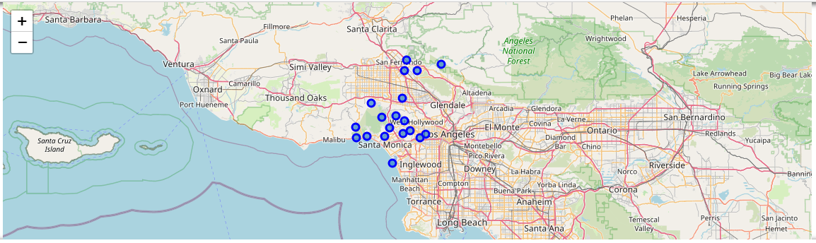
Obtaining, Validating and Cleaning the Data
Data was obtained from the “SOCR Data - Los Angeles City Neighborhoods Data”, this data was used to obtain the neighborhoods with the highest median income, the was validated on the Los Angeles Map
These neighborhoods were then used to query the Foursquare API to obtain venue data
The one hot encoding technique was used to reassign the Venue Categories as column headers and obtain the frequencies of visit for each Neighborhood
The venue data was then filtered to obtain the restaurant data

Slide 4
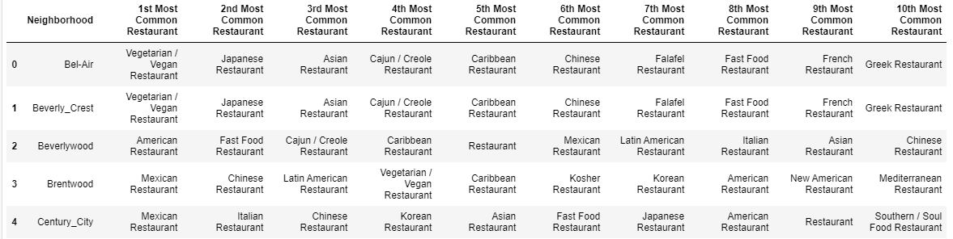
Data Analysis of Cleaned Dataframe
Exploratory analysis of the clean dataframe was done to get an output of the top 5 restaurants for each neighborhood and the associated frequencies
A new dataframe was completed that shows the top ten most common venues for each neighborhood, a snippet is shown below.

Slide 5
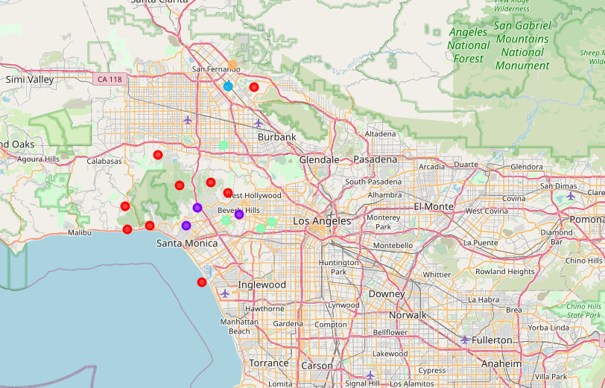
K-Means Clustering Analysis
K-Means Clustering Analysis is used to group similar neighborhoods based on the most popular cuisines
Five(5) clusters were used to classify the neighborhoods and then it was plotted on a map of Los Angeles
The major groups were Cluster 1 and Cluster 5
Cluster 1 neighborhoods preferred Vegetarian and Japanese cuisines and were located around the same area
Cluster 5 neighborhoods were extremely popular in American Cusines

Slide 6
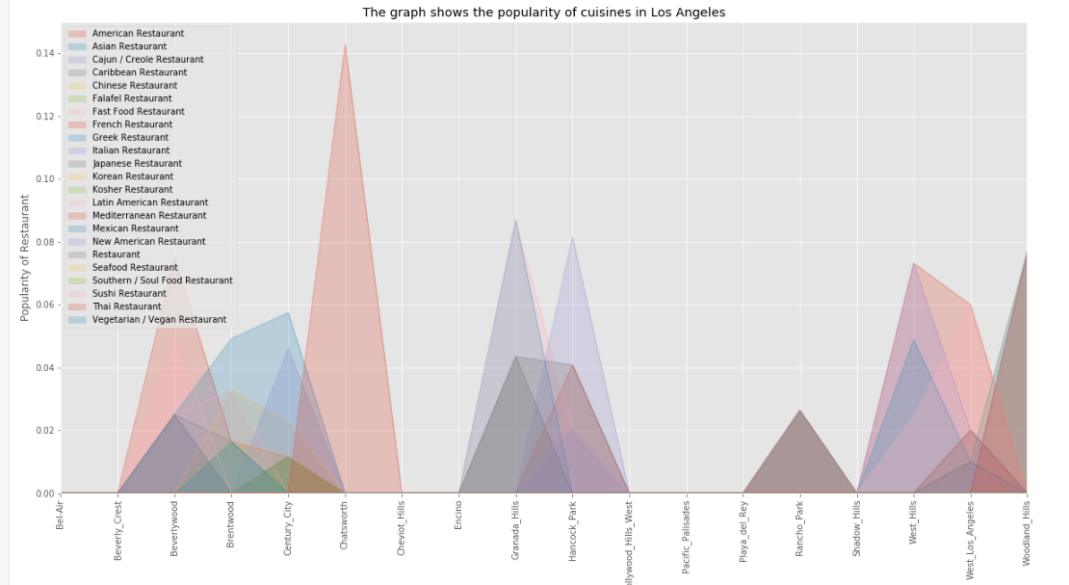
Most Frequented Restaurant Cuisine
The most frequented restaurant cuisine was determined via an Area Plot shown below.
The Area plot immediately showed American cuisine was extremely popular

Slide 7
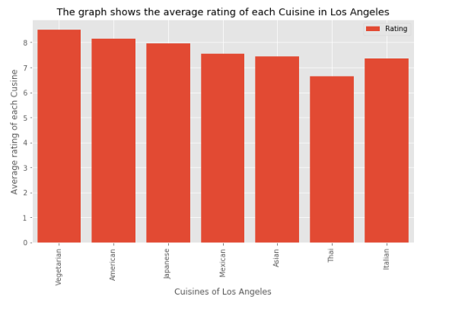
Cuisine Ratings
The most popular cuisines was chosen from the previous analysis and a sample number of venues were checked for their ratings.
The results were plotted on a bar graph below which shows Vegetarian, American and Japanese were the highest rated cuisines from the sample.

Slide 8
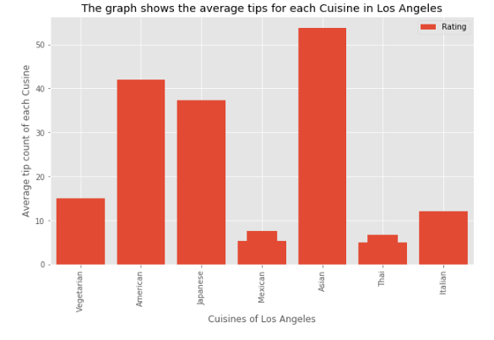
Tip Count Ratings
The most popular cuisines was chosen from the previous analysis and a sample number of venues were checked for their tip count.
The results were plotted on a bar graph below which shows Asian, American and Japanese got the highest tip counts.

Slide 9
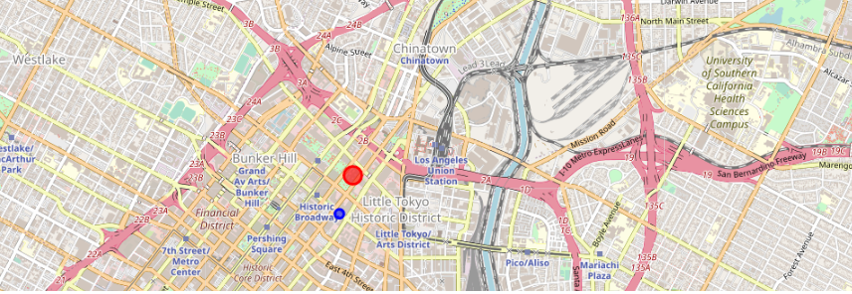
Trending Venues
The current trending restaurants were then determined by pulling the latest JSON file.
The results showed only one American restaurant was trending (blue marker) called Redbird.
Trending may have been affected by current worldwide issues.

Slide 10
Discussion
Cluster 1 neighborhoods are close together, with the exception of neighborhoods Playa del Rey and Shadow Hills, so that there is a larger consumer base for a new restaurant that is opened in any neighborhood in Cluster 1.
Cluster 1 neighborhoods shows that Vegetarian and Japanese are the most popular cuisines however there are limited venues thus it may be ideal to open restaurants with those cuisines.
Clusters 2, 3 and 4 have one neighborhood per cluster and thus any new restaurant located in these neighborhoods will have a smaller consumer base.
Cluster 5 neighborhoods are popular with American and Italian type cuisines which dominates the consumer base, thus opening a restaurant in these neighborhoods is not recommended.
Vegetarian, American and Japanese cuisines have the highest ratings for cuisine
Asian, American and Japanese have the highest tip counts

Slide 11
Conclusion
In conclusion the data points to opening a Vegetarian or Japanese type restaurant in any of the following neighborhoods:
Bel Air
Beverley Crest
Pacific Palisades
Brentwood
Cheviot Hills
Hollywood Hills West
Encino
Rancho Park
The reasons being for this include:
There are limited venues for both Vegetarian and Japanese cuisines meaning less competition amongst venues
These places are located in close proximity to each other resulting in a larger consumer base
Vegetarian and Japanese venues currently have good rating and good tip counts
Cluster 5 neighborhoods are not recommended due to the immense popularity and abundance of American cuisine
Cluster 2, 3 and 4 is not recommended due to the lower consumer base as these have single neighborhoods in each

